Slide 1
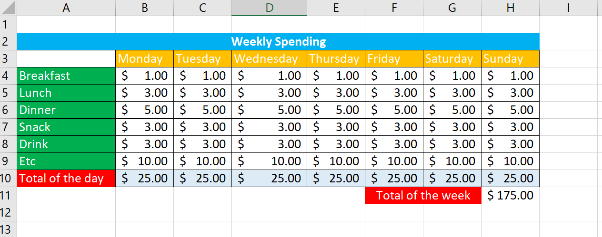
HOMEWORK 1 – WEEKLY SPENDING
1 – TOTAL OF THE DAY: The sum of payment on each days
2 – TOTAL OF THE WEEK: the sum of all total of the day

Slide 2
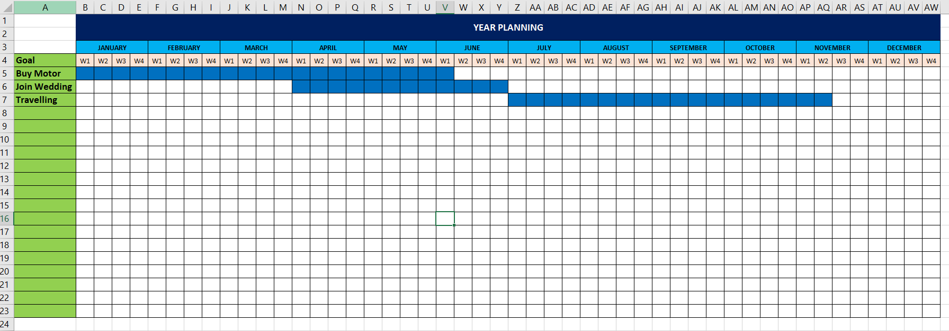
HOMEWORK 2 – YEAR PLANNING

Slide 3
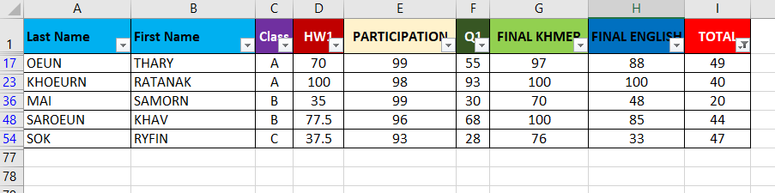
HOMEWORK 3 – Filter
Who failed final grade of Typing subject?

Slide 4
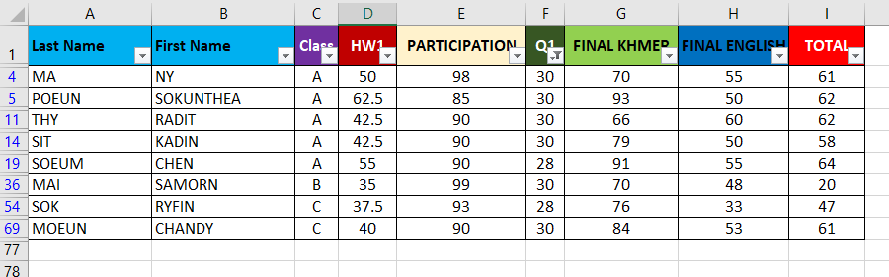
HOMEWORK 4 – Filter
Who failed Quiz of Typing subject less score or equal 30?

Slide 5
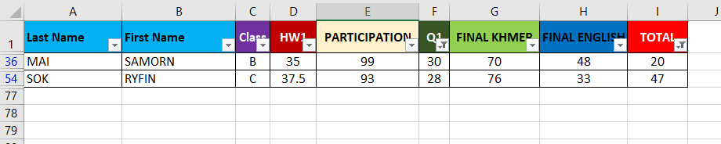
HOMEWORK 5 – Filter
Who failed Quiz and final grade of Typing?

